Slide 1

CSE440 PROJECT PRESENTATION
A Rule-Based Medical Diagnosis
Expert System
Stateless Engine Replay and History-Aware Inference over 31 Diseases
GROUP MEMBERS
AS
GN
SA
FS
Abid Shahoriar
Gazi Nihal
Syed Rakibul Hasan Apurbo
Fiad Sarowar
2211967042
2112140642
2111197642
2121365642
Dept. of Electrical and Computer Engineering, NSU
Dept. of Electrical and Computer Engineering, NSU
Dept. of Electrical and Computer Engineering, NSU
Dept. of Electrical and Computer Engineering, NSU
Medical Diagnosis Expert System | CSE440 Group No.3 Abid | Gazi | Apurbo | Fiad
1
Notes:
1

Slide 2
Introduction
A transparent, rule-based diagnosis assistant driven by symptoms and medical history
i
Project Overview
!
Key Idea: Stateless Replay
The system collects patient symptoms and medical history, represents them as facts, and applies forward-chaining production rules to suggest a possible disease along with the evidence that supports it.
The web interface does not reimplement the reasoning process. Instead it re-executes the identical console engine on every request through an input adapter that pauses whenever an unanswered question is reached.
46
31
Browser and terminal versions can never diverge
Any earlier answer can be revised and re-derived
production rules
diseases covered
History-aware inference lowers evidence thresholds
172
2
Educational and decision-support use only
symptom questions
interfaces, 1 engine
Medical Diagnosis Expert System | CSE440 Group No.3 Abid | Gazi | Apurbo | Fiad
2
Notes:
2

Slide 3
Presentation Roadmap
A complete walkthrough from problem and motivation to design, testing and future work
Problem & Motivation
Objectives & Scope
1
2
System Architecture
Inference & Implementation
3
4
Knowledge Base & Diseases
Testing, Limitations & Future Work
5
6
Medical Diagnosis Expert System | CSE440 Group No.3 Abid | Gazi | Apurbo | Fiad
3
Notes:
3

Slide 4
Problem and Motivation
Why a rule-based expert system is a natural fit for explainable diagnosis support
The Challenge
Why Expert Systems?
The Drift Problem
Medical diagnosis reasons over symptoms, patient history, risk factors and clinical knowledge. A single symptom is rarely enough for a reliable conclusion.
A rule-based system lets a user inspect exactly why a conclusion was reached: every diagnosis is a rule whose matched conditions are visible.
Student projects often rewrite reasoning in the web layer, and the two copies drift apart. This project keeps one engine as the single source of truth.
Medical Diagnosis Expert System | CSE440 Group No.3 Abid | Gazi | Apurbo | Fiad
4
Notes:
4

Slide 5
Project Objectives and Scope
What the system is designed to do — and what it is not designed to do
✓
Main Objectives
$
System Scope
Design an expert system driven by symptoms and history
Supports 31 diseases across 9 clinical categories
Represent knowledge as facts, rules and thresholds
Uses question-by-question symptom collection
Share one rule base across console and web interfaces
Does not perform lab analysis or imaging
Let a user revise an earlier answer mid-consultation
Does not replace clinical examination or triage
Use medical history to adjust evidence thresholds
Output must be reviewed by a healthcare professional
Export a disease-specific treatment PDF report
Educational and decision-support purposes only
Medical Diagnosis Expert System | CSE440 Group No.3 Abid | Gazi | Apurbo | Fiad
5
Notes:
5

Slide 6
Overall System Architecture
Six connected components turn a user's answers into a diagnosis and report
User
Interface
Session &
Question Ctrl
Input
Adapter
Inference
Engine
Disease
Knowledge Base
Treatment &
Report
Architecture Purpose
Separating symptom collection, reasoning, knowledge storage and output generation keeps each part easy to test and maintain. The web front end never reimplements diagnostic logic — it drives the same inference engine as the console application through the input adapter, so the two interfaces cannot disagree.
• Flask web front end + console front end
• EngineIOAdapter — stateless replay & pause
• DiagnosisFlow — session & question controller
• symptoms.ods + diseases_list.txt knowledge base
• MedicalExpert — Experta engine, 46 rules
• Markdown/HTML treatment docs + PDF writer
Medical Diagnosis Expert System | CSE440 Group No.3 Abid | Gazi | Apurbo | Fiad
6
Notes:
6

Slide 7
Inference Flow
Forward-chaining reasoning from patient answers to a matched, threshold-checked disease
Start
Consultation
Collect
History & Symptoms
Store Answers
as Facts
Activate Branch
by Salience
Evaluate
Gate + Threshold
Explainable
Result
Diagnostic Criterion
Salience Resolves Shared Branches
A disease d is reported when its gate symptoms G(d) are all present
AND at least θd of its supporting symptoms S(d) are present.
Several diseases live in the same question branch. Salience orders which is tested first, so the more specific disease is offered before the general one.
High fever
Dengue (0) → Typhoid (–10) → Chikungunya (–20)
Example — Tuberculosis: gate = {normal fever, chest pain, fatigue, chills}, supporting set has 4 symptoms, θ = 2. The gate keeps the branch specific; the threshold stops a diagnosis being issued on one generic symptom.
Low fever
Bronchitis (0) → Sinusitis (–10) → Common cold (–20)
Example — Dengue: high fever gate, 7-symptom supporting set, θ = 5.
Breathlessness
Asthma (0) → COPD (–10)
Medical Diagnosis Expert System | CSE440 Group No.3 Abid | Gazi | Apurbo | Fiad
7
Notes:
7

Slide 8
Implementation Overview
One rule base drives a console engine and a Flask web app through stateless replay
Console Diagnosis Engine
Web-Based Interface
expert.py holds the MedicalExpert knowledge engine with all 46 rules and prints a full terminal consultation.
web.py built in Flask. 10 routes render questions, store answers and return early predictions as HTML fragments.
Stateless Engine Replay
Treatment & PDF Module
EngineIOAdapter re-runs the console engine on every request and pauses on the first unanswered question — the web layer holds no diagnostic logic of its own.
Per-disease Markdown/HTML treatment files, plus a from-scratch PDF writer that lays out a report with no external PDF library.
Main tools: Python 3.8+ • Experta 1.9.4 • Flask 3.1.3 • HTML/CSS/JS • Custom PDF writer • LibreOffice (.ods)
Medical Diagnosis Expert System | CSE440 Group No.3 Abid | Gazi | Apurbo | Fiad
8
Notes:
8

Slide 9
Disease Knowledge Base
31 supported diseases organized into 7 clinical symptom groups
9
6
5
5
3
2
1
Respiratory
Vector-borne
GI / Hepatic
Metabolic
Eye-related
Cardiovascular
Musculoskeletal
Category Distribution Highlights the Prototype's Breadth
1 Diabetes 2 Coronary Arteriosclerosis 3 Pneumonia 4 Asthma 5 Anemia 6 Hypothyroidism 7 AIDS 8 Dehydration
9 Obesity 10 Arthritis 11 Bronchitis 12 Pancreatitis 13 Peptic Ulcer 14 Gastritis 15 Hepatitis 16 Influenza
17 Tuberculosis 18 Malaria 19 Dengue 20 Corona Virus 21 Conjunctivitis 22 Eye Allergy 23 Typhoid
24 Chikungunya 25 Sinusitis 26 Common Cold 27 UTI 28 Gastroenteritis 29 COPD 30 Hyperthyroidism 31 Dry Eye Syndrome
Medical Diagnosis Expert System | CSE440 Group No.3 Abid | Gazi | Apurbo | Fiad
9
Notes:
9

Slide 10
Symptom Categories
The 172 symptom questions are organized into 8 clinical categories
Respiratory
Gastrointestinal
Hepatic / Urinary
Vector-borne
cough, chest pain, wheezing, breathlessness
nausea, vomiting, abdominal pain, bloating
dark urine, pale stool, jaundice, burning urination
high fever, rash, retro-orbital pain, joint pain
Metabolic / Endocrine
Cardiovascular
Eye-related
General
thirst, frequent urination, weight change, heat intolerance
chest heaviness, arm pain, irregular heartbeat
redness, crusting, irritation, gritty feeling
fatigue, chills, night sweats, appetite loss
Example symptoms shown per category; the full reference table lives in symptoms.ods (246 disease-symptom entries).
Medical Diagnosis Expert System | CSE440 Group No.3 AbId | Gazi | Apurbo | Fiad
10
Notes:
10

Slide 11
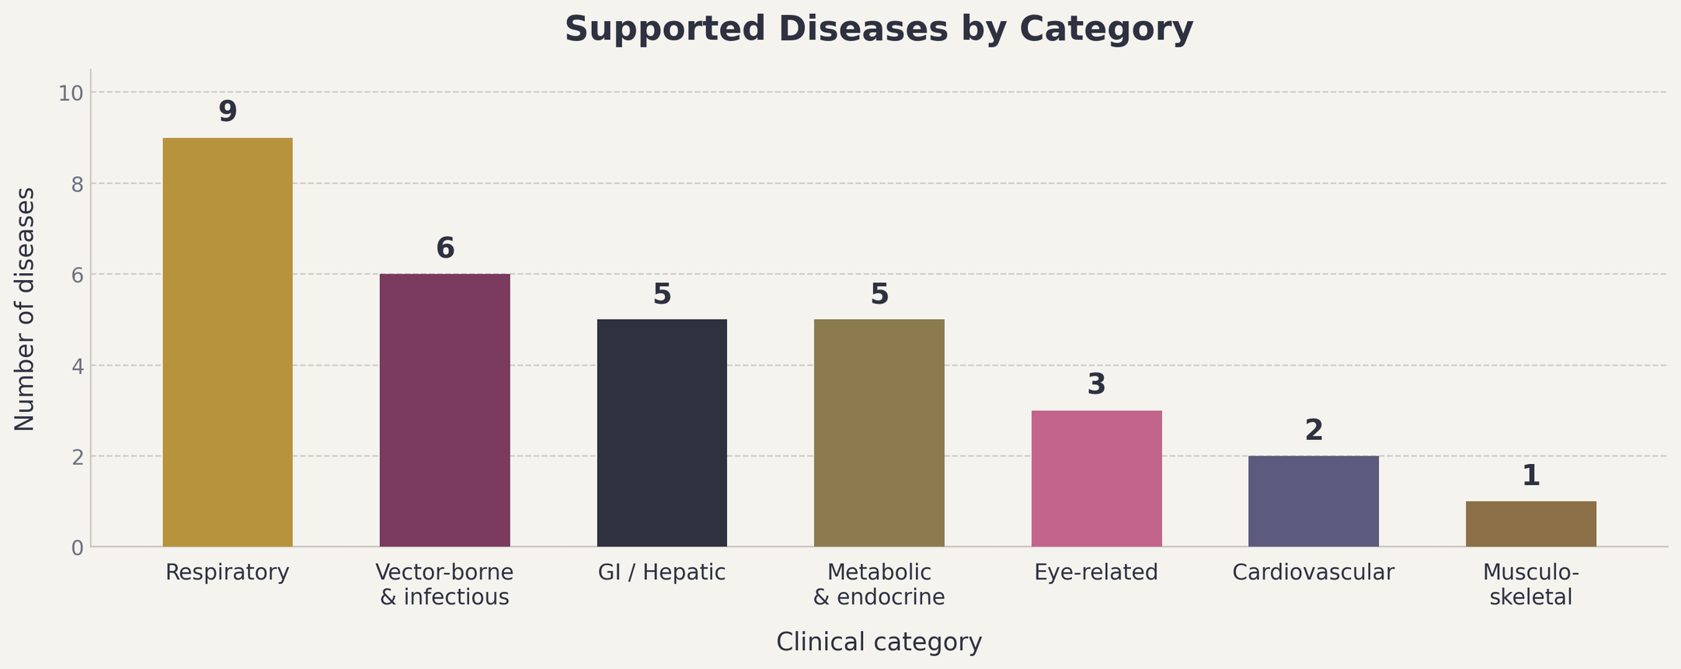
Supported Diseases by Category
Respiratory and vector-borne conditions form the largest groups
Medical Diagnosis Expert System | CSE440 Group No.3 Abid | Gazi | Apurbo | Fiad
11
Notes:
11

Slide 12
Testing and Evaluation
Scenario-based tests verify software behavior, not clinical accuracy
Functional Cases
Sample Trace — Asthma
Evaluation Limitation
Pneumonia, Dengue, Diabetes,
Asthma, TB and more —
disease reached matches
expected output
Red eyes? No
Fatigue? No
Shortness of breath? Yes
Appetite loss? No
Fever? None
Back/joint pain? No
Chest pain? Yes
Cough frequently? Yes
Wheeze on exhale? Yes
→ Diagnosis: Asthma
Evidence: breathlessness,
chest pain, cough, wheezing
Testing confirms the software logic behaves as specified, thresholds are enforced, and console and web paths agree.
It does not prove clinical accuracy. Real medical validation would need expert-reviewed cases and metrics such as sensitivity and specificity — no such evaluation was performed, and none should be inferred.
Threshold tests: below-threshold
case yields no diagnosis; at-
threshold case yields it
History tests: relaxation fires
only when the condition was
actually declared
INTERNIST-1 held a far larger knowledge base and was still reported unsuitable for clinical use — a passing test suite says nothing about diagnostic accuracy.
Medical Diagnosis Expert System | CSE440 Group No.3 Abid | Gazi | Apurbo | Fiad
12
Notes:
12

Slide 13
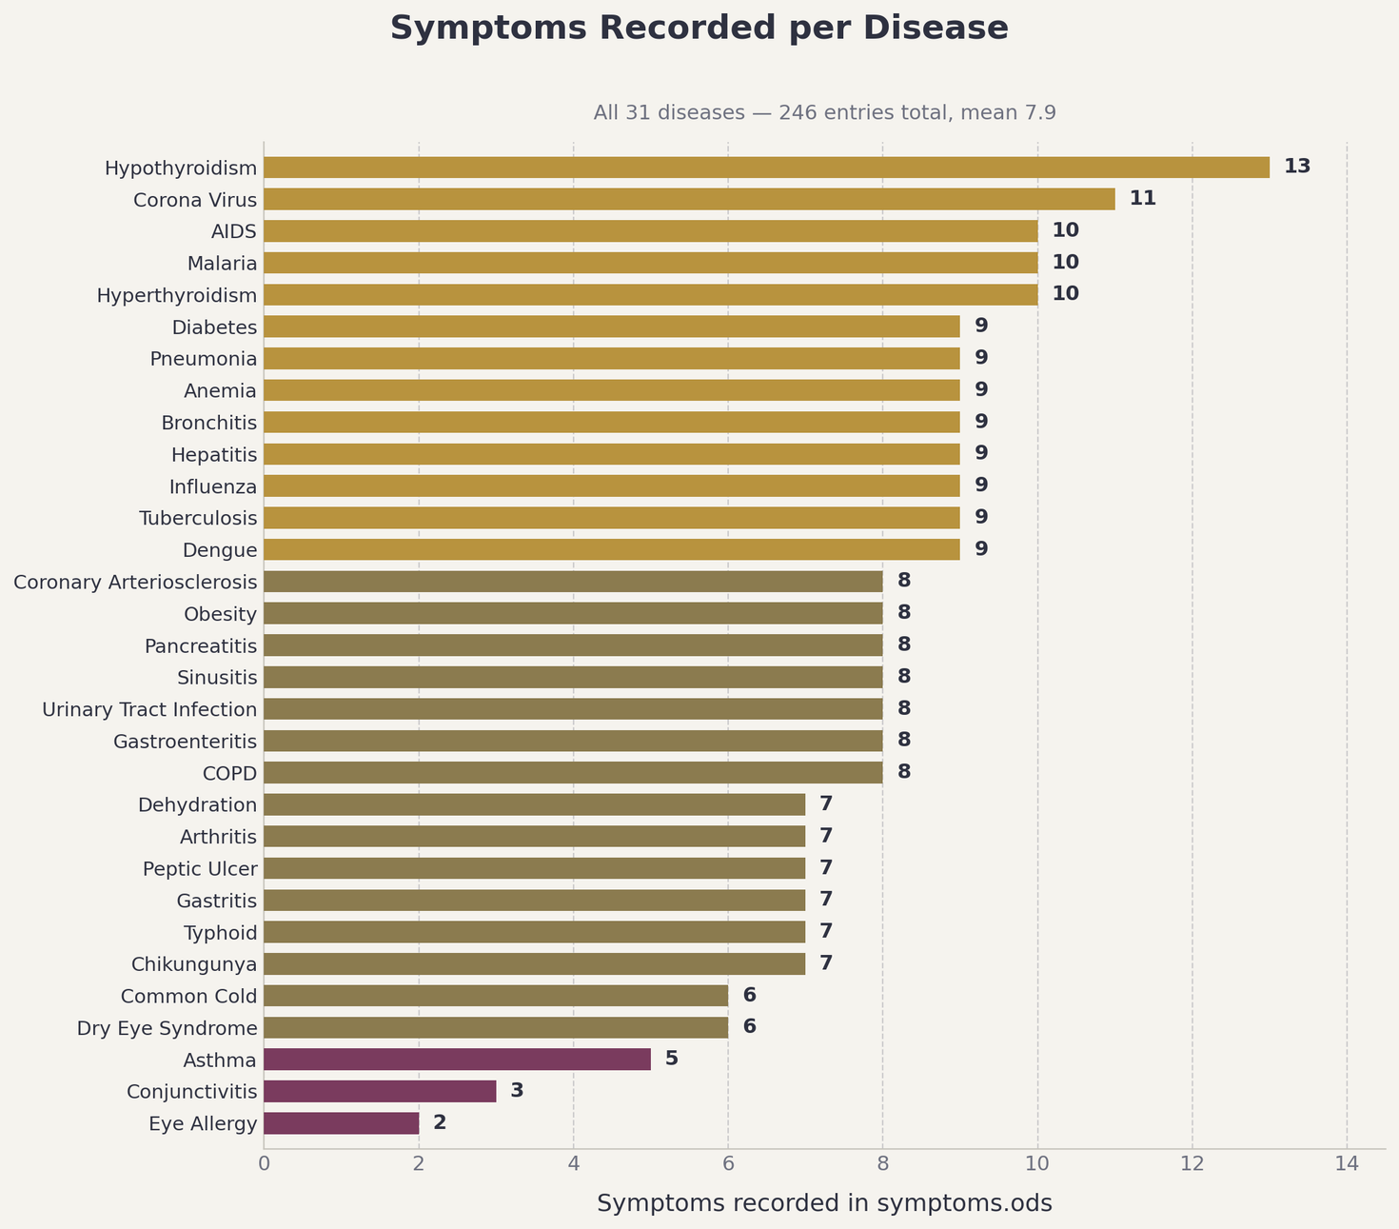
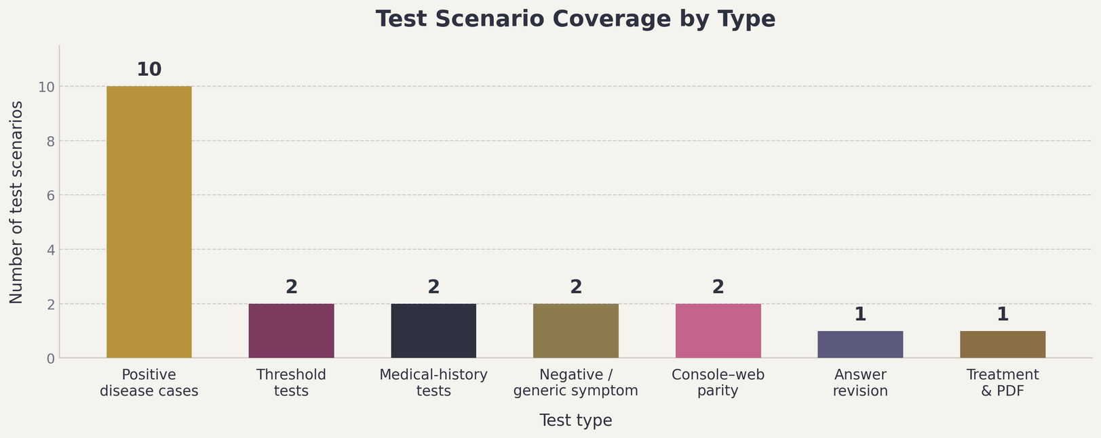
Medical Diagnosis Expert System | CSE440 Group No.3 Abid | Gazi | Apurbo | Fiad
13
Notes:
13

Slide 14
Discussion and Future Improvements
Where the prototype is strong, where it is limited, and what comes next
Strengths
Limitations
Future Work
Transparent reasoning — rules are easy to inspect
Rules hand-authored, not clinician-reviewed
Move rules into a declarative JSON/YAML file
Console & web interfaces cannot diverge
No lab, imaging or vital-sign data used
Add red-flag detection for urgent symptoms
Treatment content lives outside the engine
Only one disease reported per consultation
Rank multiple diseases with a probabilistic score
No external PDF dependency required
Sessions held in memory only
Add multilingual support, starting with Bangla
Medical Diagnosis Expert System | CSE440 Group No.3 Abid | Gazi | Apurbo | Fiad
14
Notes:
14

Slide 15
Conclusion
Final takeaway from the rule-based medical diagnosis expert system
This project demonstrates a medical diagnosis expert system built on logic programming and rule-based knowledge representation.
1
Converts patient answers into structured facts
2
Applies disease rules to infer a possible diagnosis
3
Explains output using the matched symptoms
4
Connects diagnosis to treatment info and a PDF report
5
Designed for education and preliminary decision support only
Medical Diagnosis Expert System | CSE440 Group No.3 Abid | Gazi | Apurbo | Fiad
15
Notes:
15

Slide 16
THANK YOU
Questions and discussion
Medical Diagnosis Expert System | CSE440
16
Notes:
16

